Slide 1
Tuesday, December 20, 2016
Write In Your Agenda:
Write In Your Monitoring Log:
CW:
Eclipses.
Final Review.
HW:
Looking for donations of Oreo cookies for moon phases activity.
Response to Warm-Up:
Compare and contrast spring tides and neap tides.
You will need:
Pencil

Slide 2
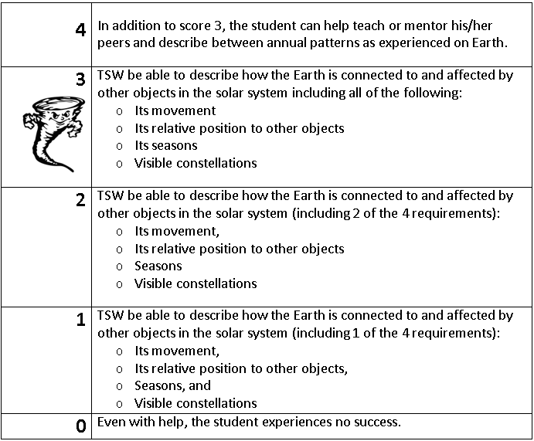
Learning Goal and Scale
TSW be able to describe how the Earth is connected to and affected by other objects in the solar system (including its movement, its relative position to other objects, its seasons, and visible constellations).

